Slide 1
Christofides Algorithm Implementation
Speaker : Jae Sung Choi

Slide 2
Development Circumstance
Java version :j2sdk1.4.1
Platform : Window XP
Java Applet
Relative Application : IE 5.0

Slide 3
Steps for Implementation
1. Insert Basic Information.
2. Find Minimum Spanning Tree
3. Find Odd degree vertices
4. Minimum Weight Matching
5. Find Euler Cycle Path
6. Find TSP Cycle Path

Slide 4
Insert Basic Information
Input vertex information
- Clicking on the Applet window by user.
Edge Information :
- Distance : Distance between each two vertices.
- Each edge has start point and end point.

Slide 5
Insert Basic Information(2)
class Nodes extends Object {
int vId;
Point xy;
boolean startFlag;
boolean oddFlag;
}
class Edges extends Object{
int eId;
int start;
int end;
double distance;
boolean passed;
}

Slide 6
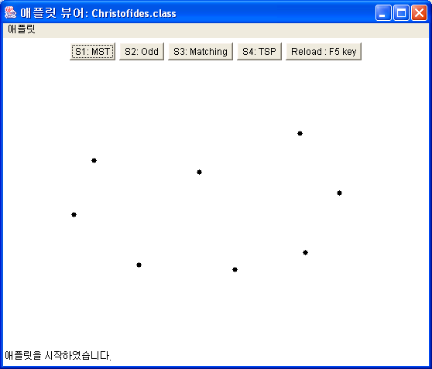
Insert Basic Information(3)
Example of insert vertex information

Slide 7
Find Minimum Spanning Tree
Used Kruskal’s Algorithm for MST
- Running Time : O(n log n)
- Prim’s algorithm has longer running time such as O(n²)

Slide 8
Find Minimum Spanning Tree
Calculate all edge’s distance.
Quick Sort for each edge’s distance
Choose Edge which has shortest distance.
Avoid cycle.

Slide 9
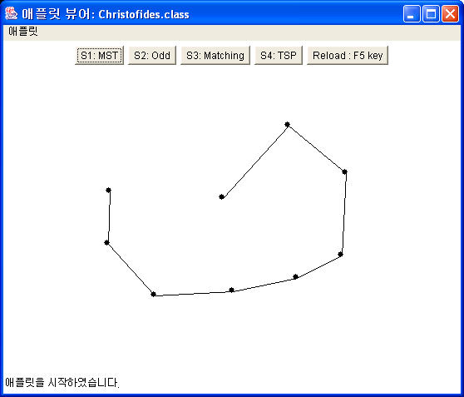
Find Minimum Spanning Tree

Slide 10
Find Odd degree vertices
In MST, there are odd degree vertices.
Find odd degree vertices.
How to find?
- Each vertex is connected with at least one edge.
- Count edge number which is connected to the chose vertex.
- Every end vertex in MST is odd degree vertex.

Slide 11
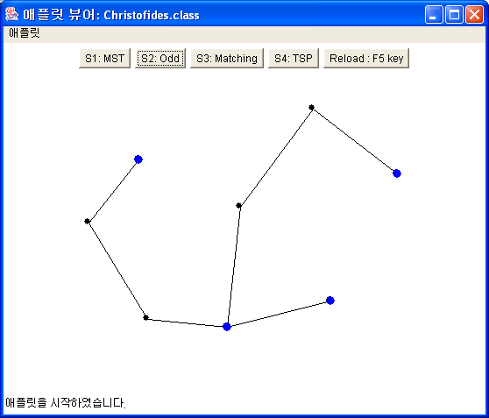
Find Odd degree vertices

Slide 12
Minimum Weight Matching
Matching with minimum weight in set of odd degree vertices.
- Calculate all distances between each odd degree vertices in the MST.
- Choose shortest (closest) distance for matching.
- Not Optimization.

Slide 13
Minimum Weight Matching
Matching step is most important step for find shortest Travel Salesman Path.

Slide 14
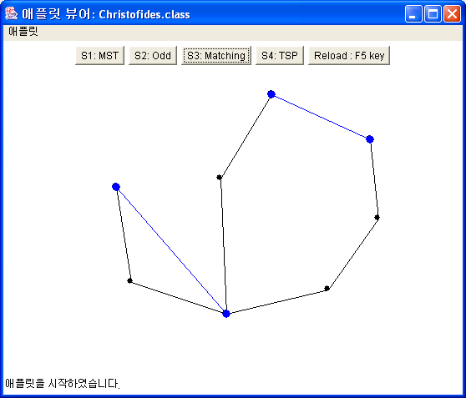
Minimum Weight Matching

Slide 15
Find Euler Cycle Path
After combine the Matching graph and MST graph…
Find a path through the combined graph which starts and ends at the same vertex
Every edge can be visited exactly once.

Slide 16
Find TSP Cycle Path
Using a short-cut concept, we visit each vertex exactly once.
- Follow sequence of found Euler Cycle path.
- If the sequence violates TSP rule, find next vertex which is not visited=>Short-Cut
- Then continue follow the Euler Cycle path until we find start point.

Slide 17
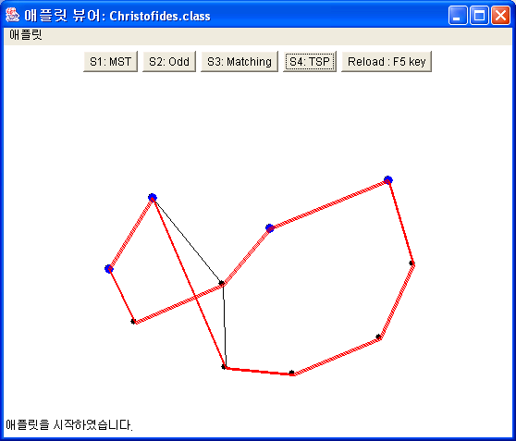
Find TSP Cycle Path
Short Cut

Slide 18
Run Chistofides Algorithm
http://student.uta.edu/js/jsc6567/demo/christofides.htm
Source : http://student.uta.edu/js/jsc6567/demo/christofides.java

